Slide 1
CSS Tables

Slide 2
TABLES
You can set the following properties of a table:
The border-collapse specifies whether the browser should control the appearance of the adjacent borders that touch each other or whether each cell should maintain its style.
The border-spacing specifies the width that should appear between table cells.

Slide 3
TABLES
The caption-side captions are presented in the <caption> element.
By default, these are rendered above the table in the document.
You use the caption-side property to control the placement of the table caption.
The empty-cells specifies whether the border should be shown if a cell is empty.

Slide 4
TABLES
The table-layout allows browsers to speed up the layout of a table by using the first width properties it comes across for the rest of a column rather than having to load the whole table before rendering it.
Now, we will see how to use these properties with examples.

Slide 5
The order-collapse Property
This property can have two values collapse and separate.
The following example uses both the values:

Slide 6
The order-collapse Property
<style type="text/css">
table.one {border-collapse:collapse;}
table.two {border-collapse:separate;}
td.a {
border-style:dotted;
border-width:3px;
border-color:#000000;
padding: 10px;
}

Slide 7
The order-collapse Property
td.b {border-style:solid;
border-width:3px;
border-color:#333333;
padding:10px;
}
</style>

Slide 8
The order-collapse Property
<table class="one">
<caption>Collapse Border Example</caption>
<tr><td class="a"> Cell A Collapse Example</td></tr>
<tr><td class="b"> Cell B Collapse Example</td></tr>
</table>
<br />

Slide 9
The order-collapse Property
<table class="two">
<caption>Separate Border Example</caption>
<tr><td class="a"> Cell A Separate Example</td></tr>
<tr><td class="b"> Cell B Separate Example</td></tr>
</table>

Slide 10
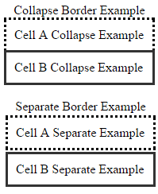
The order-collapse Property
It will produce the following result:

Slide 11
The border-spacing Property
The border-spacing property specifies the distance that separates the adjacent cells’ borders.
It can take either one or two values; these should be units of length.

Slide 12
The border-spacing Property
If you provide one value, it applies to both vertical and horizontal borders.
Or you can specify two values, in which case, the first refers to the horizontal spacing and the second to the vertical spacing:
NOTE: Unfortunately, this property does not work in Netscape 7 or IE 6.

Slide 13
The border-spacing Property
<style type="text/css">
/* If you provide one value */
table.example {border-spacing:10px;}
/* This is how you can provide two values */
table.example {border-spacing:10px; 15px;}
</style>
Now let's modify the previous example and see the effect:

Slide 14
The border-spacing Property
<style type="text/css">
table.one {
border-collapse:separate;
width:400px;
border-spacing:10px;
}
table.two {
border-collapse:separate;
width:400px;
border-spacing:10px 50px;
}
</style>

Slide 15
The border-spacing Property
<table class="one" border="1">
<caption>Separate Border Example with border-spacing</caption>
<tr><td> Cell A Collapse Example</td></tr>
<tr><td> Cell B Collapse Example</td></tr>
</table>
<br />

Slide 16
The border-spacing Property
<table class="two" border="1">
<caption>Separate Border Example with border-spacing</caption>
<tr><td> Cell A Separate Example</td></tr>
<tr><td> Cell B Separate Example</td></tr>
</table>

Slide 17
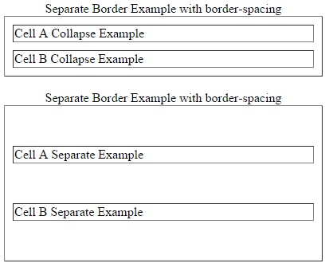
The border-spacing Property

Slide 18
The caption-side Property
The caption-side property allows you to specify where the content of a <caption> element should be placed in relationship to the table. The table that follows lists the possible values
This property can have one of the four values top, bottom, left, or right.
The following example uses each value.
NOTE: These properties may not work with your IE Browser. .

Slide 19
The caption-side Property
<style type="text/css">
caption.top {caption-side:top}
caption.bottom {caption-side:bottom}
caption.left {caption-side:left}
caption.right {caption-side:right}
</style>

Slide 20
The caption-side Property
<table style="width:400px; border:1px solid black;">
<caption class="top">
This caption will appear at the top
</caption>
<tr><td > Cell A</td></tr>
<tr><td > Cell B</td></tr>
</table>
<br />

Slide 21
The caption-side Property
<table style="width:400px; border:1px solid black;">
<caption class="bottom">
This caption will appear at the bottom
</caption>
<tr><td > Cell A</td></tr>
<tr><td > Cell B</td></tr>
</table>
<br />

Slide 22
The caption-side Property
<table style="width:400px; border:1px solid black;">
<caption class="left">
This caption will appear at the left
</caption>
<tr><td > Cell A</td></tr>
<tr><td > Cell B</td></tr>
</table>
<br />

Slide 23
The caption-side Property
<table style="width:400px; border:1px solid black;">
<caption class="right">
This caption will appear at the right
</caption>
<tr><td > Cell A</td></tr>
<tr><td > Cell B</td></tr>
</table>

Slide 24
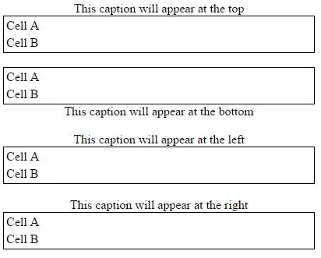
The caption-side Property

Slide 25
The empty-cells Property
The empty-cells property indicates whether a cell without any content should have a border displayed.
This property can have one of the three values - show, hide, or inherit.
Here is the empty-cells property used to hide borders of empty cells in the <table> element.

Slide 26
The empty-cells Property
<style type="text/css">
table.empty{
width:350px;
border-collapse:separate;
empty-cells:hide;
}
td.empty{
padding:5px;
border-style:solid;
border-width:1px;
border-color:#999999;
}
</style>

Slide 27
The empty-cells Property
<table class="empty">
<tr>
<th></th>
<th>Title one</th>
<th>Title two</th>
</tr>
<tr>
<th>Row Title</th>
<td class="empty">value</td>
<td class="empty">value</td>
</tr>
<tr>
<th>Row Title</th>
<td class="empty">value</td>
<td class="empty"></td>
</tr>
</table>

Slide 28
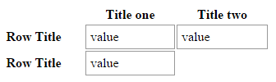
The empty-cells Property

Slide 29
The table-layout Property
The table-layout property is supposed to help you control how a browser should render or lay out a table.
This property can have one of the three values: fixed, auto, or inherit.
The following example shows the difference between these properties.
NOTE: This property is not supported by many browsers, so do not rely on this property.

Slide 30
The table-layout Property
<style type="text/css">
table.auto
{
table-layout: auto
}
table.fixed
{
table-layout: fixed
}
</style>

Slide 31
The table-layout Property
<table class="auto" border="1" width="100%">
<tr>
<td width="20%">1000000000000000000000000000</td>
<td width="40%">10000000</td>
<td width="40%">100</td>
</tr>
</table>
<br />

Slide 32
The table-layout Property
<table class="fixed" border="1" width="100%">
<tr>
<td width="20%">1000000000000000000000000000</td>
<td width="40%">10000000</td>
<td width="40%">100</td>
</tr>
</table>

Slide 33

The table-layout Property

Slide 34
BORDERS
The border properties allow you to specify how the border of the box representing an element should look.
There are three properties of a border you can change:
The border-color specifies the color of a border.
The border-style specifies whether a border should be solid, dashed line, double line, or one of the other possible values.
The border-width specifies the width of a border.

Slide 35
The border-color Property
The border-color property allows you to change the color of the border surrounding an element.
You can individually change the color of the bottom, left, top and right sides of an element's border using the properties:

Slide 36
The border-color Property
border-bottom-color changes the color of bottom border.
border-top-color changes the color of top border.
border-left-color changes the color of left border.
border-right-color changes the color of right border.
The following example shows the effect of all these properties:

Slide 37
The border-color Property
<style type="text/css">
p.example1{
border:1px solid;
border-bottom-color:#009900; /* Green */
border-top-color:#FF0000; /* Red */
border-left-color:#330000; /* Black */
border-right-color:#0000CC; /* Blue */
}

Slide 38
The border-color Property
p.example2{
border:1px solid;
border-color:#009900; /* Green */
}
</style>
<p class="example1">
This example is showing all borders in different colors.
</p>
<p class="example2">
This example is showing all borders in green color only.
</p>

Slide 39

The border-color Property
It will produce the following result:

Slide 40
The border-style Property
The border-style property allows you to select one of the following styles of border:
none: No border. (Equivalent of border-width:0;)
solid: Border is a single solid line.
dotted: Border is a series of dots.
dashed: Border is a series of short lines.
double: Border is two solid lines.

Slide 41
The border-style Property
groove: Border looks as though it is carved into the page.
ridge: Border looks the opposite of groove.
inset: Border makes the box look like it is embedded in the page.
outset: Border makes the box look like it is coming out of the canvas.
hidden: Same as none, except in terms of border-conflict resolution for table elements.

Slide 42
The border-style Property
You can individually change the style of the bottom, left, top, and right borders of an element using the following properties:
border-bottom-style changes the style of bottom border.
border-top-style changes the style of top border.
border-left-style changes the style of left border.
border-right-style changes the style of right border.
The following example shows all these border styles:

Slide 43
The border-style Property
<p style="border-width:4px; border-style:none;">
This is a border with none width.
</p>
<p style="border-width:4px; border-style:solid;">
This is a solid border.
</p>
<p style="border-width:4px; border-style:dashed;">
This is a dahsed border.
</p>

Slide 44
The border-style Property
<p style="border-width:4px; border-style:double;">
This is a double border.
</p>
<p style="border-width:4px; border-style:groove;">
This is a groove border.
</p>
<p style="border-width:4px; border-style:ridge">
This is aridge border.
</p>

Slide 45
The border-style Property
<p style="border-width:4px; border-style:inset;">
This is a inset border.
</p>
<p style="border-width:4px; border-style:outset;">
This is a outset border.
</p>
<p style="border-width:4px; border-style:hidden;">
This is a hidden border.
</p>

Slide 46
The border-style Property
<p style="border-width:4px;
border-top-style:solid;
border-bottom-style:dashed;
border-left-style:groove;
border-right-style:double;">
This is a a border with four different styles.
</p>

Slide 47
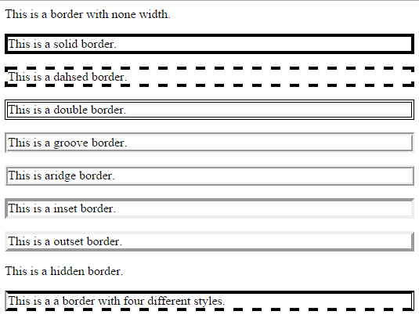
The border-style Property

Slide 48
The border-width Property
The border-width property allows you to set the width of an element borders.
The value of this property could be either a length in px, pt, or cm, or it should be set to thin, medium, or thick.
You can individually change the width of the bottom, top, left, and right borders of an element using the following properties:

Slide 49
The border-width Property
border-bottom-width changes the width of bottom border.
border-top-width changes the width of top border.
border-left-width changes the width of left border.
border-right-width changes the width of right border.
The following example shows all these border width:

Slide 50
The border-width Property
<p style="border-width:4px; border-style:solid;">
This is a solid border whose width is 4px.
</p>
<p style="border-width:4pt; border-style:solid;">
This is a solid border whose width is 4pt.
</p>
<p style="border-width:thin; border-style:solid;">
This is a solid border whose width is thin.
</p>

Slide 51
The border-width Property
<p style="border-width:medium; border-style:solid;">
This is a solid border whose width is medium;
</p>
<p style="border-width:thick; border-style:solid;">
This is a solid border whose width is thick.
</p>

Slide 52
The border-width Property
<p style="border-bottom-width:4px;
border-top-width:10px;
border-left-width: 2px;
border-right-width:15px;
border-style:solid;">
This is a a border with four different width.
</p>

Slide 53
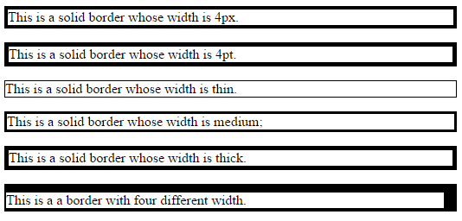
The border-width Property

Slide 54
Border Properties Using Shorthand
The border property allows you to specify color, style, and width of lines in one property:
The following example shows how to use all the three properties into a single property.
This is the most frequently used property to set border around any element

Slide 55
Border Properties Using Shorthand
<p style="border:4px solid red;">
This example is showing shorthand property for border.
</p>
It will produce the following result:

Slide 56
MARGINS
The margin property defines the space around an HTML element.
It is possible to use negative values to overlap content.
The values of the margin property are not inherited by the child elements.
We have the following properties to set an element margin.

Slide 57
MARGINS
The margin specifies a shorthand property for setting the margin properties in one declaration.
The margin-bottom specifies the bottom margin of an element.
The margin-top specifies the top margin of an element.
The margin-left specifies the left margin of an element.
The margin-right specifies the right margin of an element.

Slide 58
The Margin Property
The margin property allows you to set all of the properties for the four margins in one declaration.
Here is the syntax to set margin around a paragraph:

Slide 59
The Margin Property
<style type="text/css">
p {margin: 15px}
all four margins will be 15px
p {margin: 10px 2%}
top and bottom margin will be 10px, left and right margin will be 2% of the total width of the document.

Slide 60
The Margin Property
p {margin: 10px 2% -10px}
top margin will be 10px, left and right margin will be 2% of the total width of the document, bottom margin will be -10px
p {margin: 10px 2% -10px auto}
top margin will be 10px, right margin will be 2% of the total width of the document, bottom margin will be -10px, left margin will be set by the browser
</style>

Slide 61
The Margin Property
Here is an example:
<p style="margin: 15px; border:1px solid black;">
all four margins will be 15px
</p>
<p style="margin:10px 2%; border:1px solid black;">
top and bottom margin will be 10px, left and right margin will be 2% of the total width of the document.
</p>

Slide 62
The Margin Property
<p style="margin: 10px 2% -10px; border:1px solid black;">
top margin will be 10px, left and right margin will be 2% of the total width of the document, bottom margin will be -10px
</p>

Slide 63
The Margin Property
<p style="margin: 10px 2% -10px auto; border:1px solid black;">
top margin will be 10px, right margin will be 2% of the total width of the document, bottom margin will be -10px, left margin will be set by the browser
</p>

Slide 64
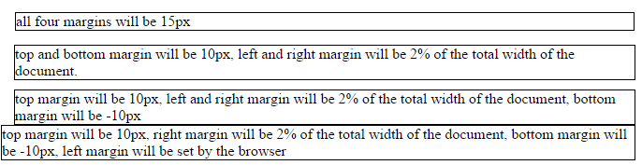
The Margin Property
It will produce the following result:

Slide 65
The margin-bottom Property
The margin-bottom property allows you to set the bottom margin of an element.
It can have a value in length, %, or auto.
Here is an example:

Slide 66
The margin-bottom Property
<p style="margin-bottom: 15px; border:1px solid black;">
This is a paragraph with a specified bottom margin
</p>
<p style="margin-bottom: 5%; border:1px solid black;">
This is another paragraph with a specified bottom margin in percent
</p>

Slide 67

The margin-bottom Property
It will produce the following result:

Slide 68
The margin-top Property
The margin-top property allows you to set the top margin of an element.
It can have a value in length, %, or auto.
Here is an example:

Slide 69
The margin-top Property
<p style="margin-top: 15px; border:1px solid black;">
This is a paragraph with a specified top margin
</p>
<p style="margin-top: 5%; border:1px solid black;">
This is another paragraph with a specified top margin in percent
</p>

Slide 70

The margin-top Property
It will produce the following result:

Slide 71
The margin-left Property
The margin-left property allows you to set the left margin of an element.
It can have a value in length, %, or auto.
Here is an example:

Slide 72
The margin-left Property
<p style="margin-left: 15px; border:1px solid black;">
This is a paragraph with a specified left margin
</p>
<p style="margin-left: 5%; border:1px solid black;">
This is another paragraph with a specified top margin in percent
</p>

Slide 73

The margin-left Property
It will produce the following result:

Slide 74
The margin-right Property
The margin-right property allows you to set the right margin of an element.
It can have a value in length, %, or auto.
Here is an example:

Slide 75
The margin-right Property
<p style="margin-right: 15px; border:1px solid black;">
This is a paragraph with a specified right margin
</p>
<p style="margin-right: 5%; border:1px solid black;">
This is another paragraph with a specified right margin in percent
</p>

Slide 76

The margin-right Property
It will produce the following result:

